Slide 1

Alignments and phylogenetic trees

Slide 2
Intro
What is an alignment?
Task of locating equivalent regions of two or more sequences to maximize their similarity
Why?
Alignment can reveal homology between sequences
Homology= similarity in sequence or structure due to descent from a common ancestor

Slide 3
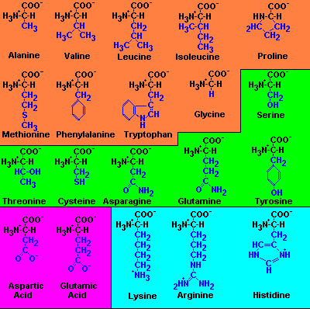
Nucleotide vs. protein alignment
Protein alignments are more precise due to higher number of combinations.
If sequences are the same they are identical
If protein sequences share chemical characteristics they are similar

Slide 4
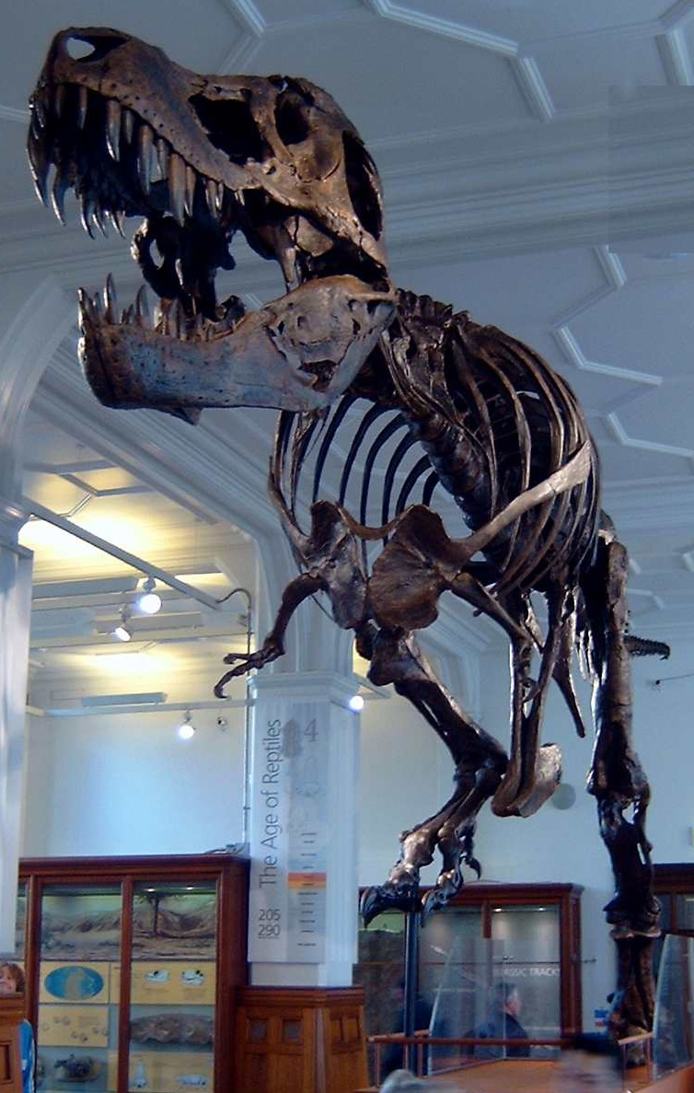
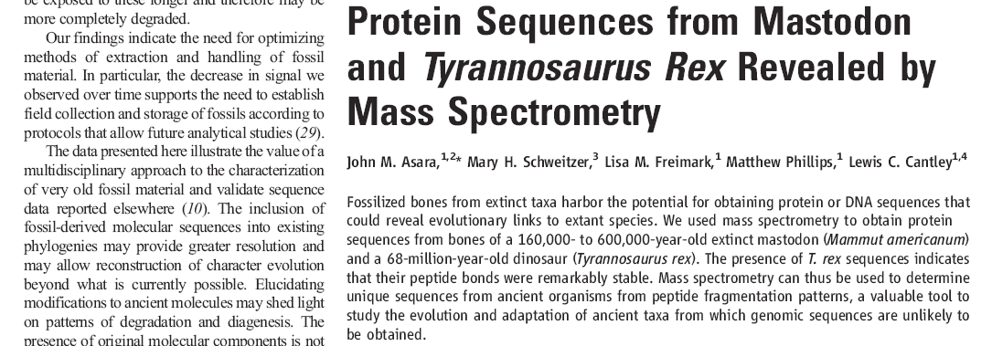
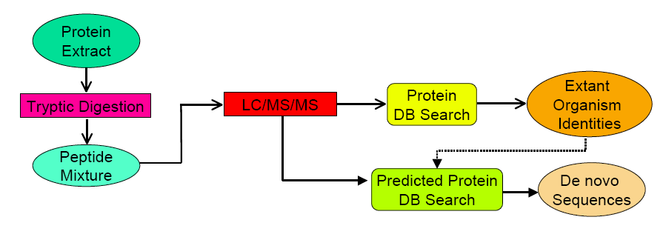
Protein from a 68-million-year-old T. rex

Slide 5

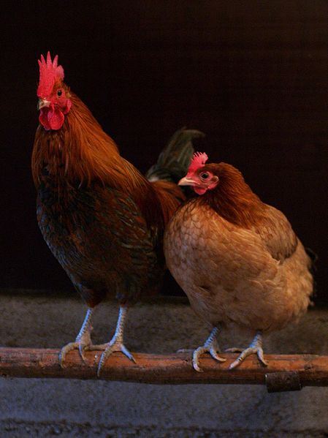
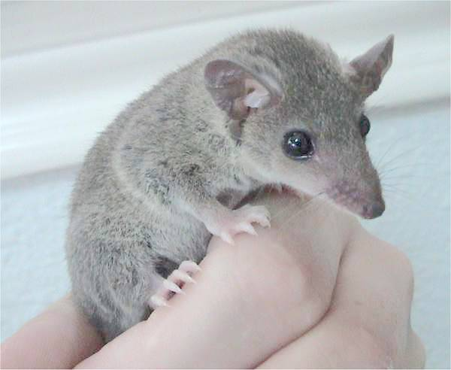
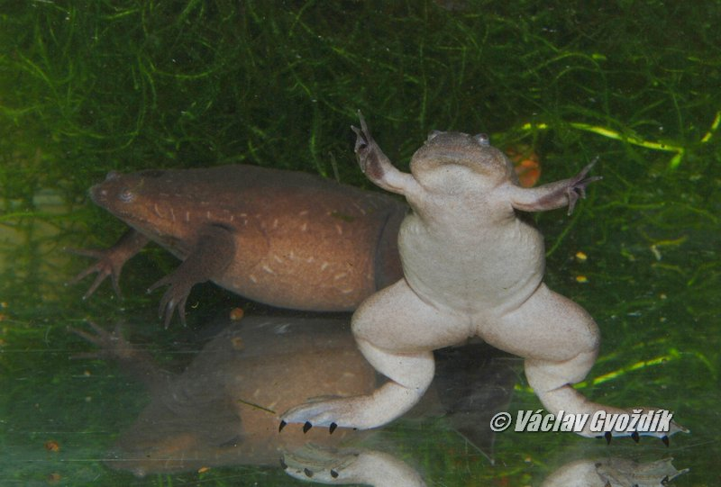
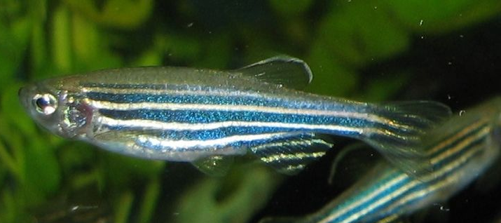
Gallus gallus
Monodelphis domestica
T. rex
Danio rerio
Xenopus tropicalis

Slide 6
Best hit = collagen
G V Q - P P G P Q G P R Tyronosaur rex (92%)
G V Q G P P G P Q G P R Chicken (91%)
- V Q R P P G P Q G P R Zebra fish (91%)
G A Q G P P G P Q G P R Wester clawed frog (84%)

Slide 7
How alignments work
1. THISSEQUENCE
2. THATSEQUENCE
T H I S S E Q U E N C E
| | | | | | | | | |
T H A T S E Q U E N C E
1. THISISASEQUENCE
2. THATSEQUENCE
T H I S I S A S E Q U E N C E
| | | |
T H A T S E Q U E N C E
T H I S I S A - S E Q U E N C E
| | | | | | | | | | |
T H - - - - A T S E Q U E N C E

Slide 8
Evaluating alignments – Substitution matrices
Shows values proportional to probability that an amino acid 1 mutates into amino acid 2
Positive values if aminoacids are chemically similar. Negative values indicates changes in chemistry.
PAM matrix (1978)
Based on global alignments of 71 protein “superfamilies”
BLOSUM matrix (1992)
Based on local alignments of bigger dataset, includes more distant proteins
Gaps are also scored, penalty for gap opening and extensions

Slide 9
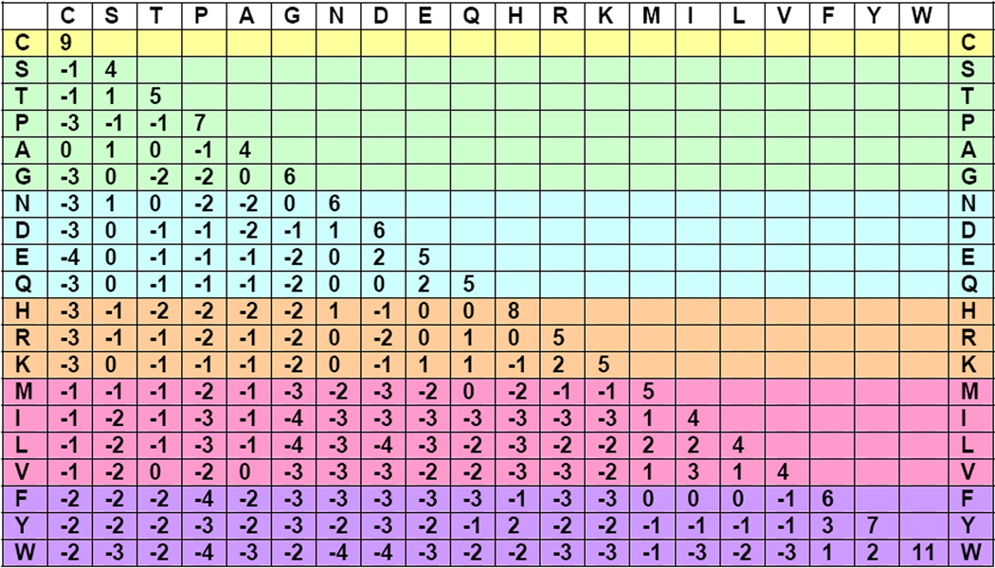
Scoring alignment with substitution matrix
T H I S S E Q U E N C E
| | | | | | | | | |
T H A T S E Q U E N C E
5 8 -1 14 5 5 0 5 6 9 5 = 52

Slide 10
How do we get to the alignment
Needleman-Wunsch algorithm
Set of rules to score positions and find alignment that maximizes sum of scores
Given two sequences: THISLINE and ALIGNED
1. Start with a zero score
2. To move horizontally or vertically we add a gap penalty (Here penalty = -8)
3. To move diagonally we add the initial score with the score from substitution matrix
4. For nucleotide alignments a scoring system of +5 match, -4 mismatch
 |  | I | S | A | L | I | G | N | E | D
 | 0 | -8 | -16 | -24 | -32 | -40 | -48 | -56 | -64 | -72
T | -8
H | -16
I | -24
S | -32
L | -40
I | -48
N | -56
E | -64

Slide 11
How do we get to the alignment
Needleman-Wunsch algorithm
Set of rules to score positions and find alignment that maximizes sum of scores
Given two sequences: THISLINE and ALIGNED
1. Start with a zero score
2. To move horizontally or vertically we add a gap penalty (Here penalty = -8)
3. To move diagonally we add the initial score with the score from substitution matrix
4. For nucleotide alignments a scoring system of +5 match, -4 mismatch
 |  | I | S | A | L | I | G | N | E | D
 | 0 | -8 | -16 | -24 | -32 | -40 | -48 | -56 | -64 | -72
T | -8 | -1 | -7 | 15 | 23 | -31 | -39 | -47 | -55 | -63
H | -16 | -9 | -2 | -9 | 17 | -25 | -33 | -40 | -47 | -55
I | -24 | -12 | -10 | -3 | -7 | -13 | -21 | -29 | -37 | -45
S | -32 | -20 | -8 | -9 | -5 | -9 | -13 | -20 | -28 | -35
L | -40 | -28 | -16 | -9 | -5 | -3 | -11 | -16 | -23 | -31
I | -48 | -36 | -24 | -17 | -7 | -1 | -7 | -14 | -19 | -26
N | -56 | -44 | -32 | -25 | -15 | -9 | -1 | -1 | -9 | 17
E | -64 | -52 | -40 | -33 | -23 | -17 | -9 | -1 | 4 | -4

Slide 12
How do we get to the alignment
Needleman-Wunsch algorithm
Set of rules to score positions and find alignment that maximizes sum of scores
Given two sequences: THISLINE and ALIGNED
1. Start with a zero score
2. To move horizontally or vertically we add a gap penalty (Here penalty = -8)
3. To move diagonally we add the initial score with the score from substitution matrix
4. For nucleotide alignments a scoring system of +5 match, -4 mismatch
 |  | I | S | A | L | I | G | N | E | D
 | 0 | -8 | -16 | -24 | -32 | -40 | -48 | -56 | -64 | -72
T | -8 | -1 | -7 | 15 | 23 | -31 | -39 | -47 | -55 | -63
H | -16 | -9 | -2 | -9 | 17 | -25 | -33 | -40 | -47 | -55
I | -24 | -12 | -10 | -3 | -7 | -13 | -21 | -29 | -37 | -45
S | -32 | -20 | -8 | -9 | -5 | -9 | -13 | -20 | -28 | -35
L | -40 | -28 | -16 | -9 | -5 | -3 | -11 | -16 | -23 | -31
I | -48 | -36 | -24 | -17 | -7 | -1 | -7 | -14 | -19 | -26
N | -56 | -44 | -32 | -25 | -15 | -9 | -1 | -1 | -9 | 17
E | -64 | -52 | -40 | -33 | -23 | -17 | -9 | -1 | 4 | -4

Slide 13
How do we get to the alignment
Needleman-Wunsch algorithm
Set of rules to score positions and find alignment that maximizes sum of scores
Given two sequences: THISLINE and ALIGNED
 |  | I | S | A | L | I | G | N | E | D
 | 0 | -8 | -16 | -24 | -32 | -40 | -48 | -56 | -64 | -72
T | -8 | -1 | -7 | 15 | 23 | -31 | -39 | -47 | -55 | -63
H | -16 | -9 | -2 | -9 | 17 | -25 | -33 | -40 | -47 | -55
I | -24 | -12 | -10 | -3 | -7 | -13 | -21 | -29 | -37 | -45
S | -32 | -20 | -8 | -9 | -5 | -9 | -13 | -20 | -28 | -35
L | -40 | -28 | -16 | -9 | -5 | -3 | -11 | -16 | -23 | -31
I | -48 | -36 | -24 | -17 | -7 | -1 | -7 | -14 | -19 | -26
N | -56 | -44 | -32 | -25 | -15 | -9 | -1 | -1 | -9 | 17
E | -64 | -52 | -40 | -33 | -23 | -17 | -9 | -1 | 4 | -4
5. After table is completed we trace back steps from maximum score to beginning
Gap penalty = -8, BLOSUM62
Global alignment, score -4
T H I S L I N E –
| |
I S A L I G N E D

Slide 14
Parameters chosen are relevant to final alignment
Gap penalty = -4, BLOSUM62
Optical alignment score 7
 |  | I | S | A | L | I | G | N | E | D
 | 0 | -4 | -8 | -12 | -16 | -20 | -24 | -28 | -32 | -36
T | -4 | -1 | -3 | -7 | -11 | -15 | -19 | -23 | -27 | -31
H | -8 | -5 | -2 | -5 | -9 | -13 | -17 | -18 | -22 | -26
I | -12 | -4 | -6 | -3 | -3 | -5 | -9 | -13 | -17 | -21
S | -16 | -8 | 0 | -4 | -5 | -5 | -5 | -8 | -12 | -16
L | -20 | -12 | -4 | -1 | 0 | -3 | -7 | -8 | -11 | -15
I | -24 | -16 | -8 | -5 | 1 | 4 | 0 | -4 | -8 | -12
N | -28 | -20 | -12 | -9 | -3 | 0 | 4 | 6 | 2 | -2
E | -32 | -24 | -16 | -13 | -7 | -4 | 0 | 4 | 11 | 7
T H I S - L I - N E –
|| | | | |
- - I S A L I G N E D

Slide 15
Global alignments are not always desired Local alignment algorithm: Smith-Waterman
Local alignment almost always used for database searches
For proteins, they contain structural/functional modules (domains).
Different regions in a protein evolve at different rates.
Features of SW algorithm
No penalty for starting the alignment at some internal position.
Alignment does not necessarily extend to the end of sequences.
Guarantee optimal alignment(s).

Slide 16
Local alignment
Gap penalty = -4, BLOSUM62
Optical alignment score 19
 |  | I | S | A | L | I | G | N | E | D
 | 0 | 0 | 0 | 0 | 0 | 0 | 0 | 0 | 0 | 0
T | 0 | 0 | 1 | 0 | 0 | 0 | 0 | 0 | 0 | 0
H | 0 | 0 | 0 | 0 | 0 | 0 | 0 | 1 | 0 | 0
I | 0 | 4 | 0 | 0 | 2 | 4 | 0 | 0 | 0 | 0
S | 0 | 0 | 8 | 4 | 0 | 0 | 4 | 1 | 0 | 0
L | 0 | 2 | 4 | 7 | 8 | 4 | 0 | 1 | 0 | 0
I | 0 | 4 | 0 | 3 | 9 | 12 | 8 | 4 | 0 | 0
N | 0 | 0 | 5 | 1 | 5 | 8 | 12 | 14 | 10 | 6
E | 0 | 0 | 1 | 4 | 1 | 4 | 8 | 12 | 19 | 15
I S - L I - N E
|| | | | |
I S A L I G N E

Slide 17
BLOSUM matrices
PAM50
PAM250
PAM500
A
R
N
D
C
Q
E
A
R
N
D
C
Q
E
A
R
N
D
C
Q
E
A
5
-5
-2
-2
-5
-3
-1
A
2
-2
0
0
-2
0
0
A
1
-1
0
1
-2
0
1
R
-5
8
-4
-7
-6
0
-7
R
-2
6
0
-1
-4
1
-1
R
-1
5
1
0
-4
2
0
N
-2
-4
7
2
-8
-2
-1
N
0
0
2
2
-4
1
1
N
0
1
1
2
-3
1
1
D
-2
-7
2
7
-11
-1
3
D
0
-1
2
4
-5
2
3
D
1
0
2
3
-5
2
3
C
-5
-6
-8
-11
9
-11
-11
C
-2
-4
-4
-5
12
-5
-5
C
-2
-4
-3
-5
22
-5
-5
Q
-3
0
-2
-1
-11
8
2
Q
0
1
1
2
-5
4
2
Q
0
2
1
2
-5
2
2
E
-1
-7
-1
3
-11
2
7
E
0
-1
1
3
-5
2
4
E
1
0
1
3
-5
2
3
BLOSUM65
BLOSUM85
A
R
N
D
C
Q
E
A
R
N
D
C
Q
E
A
4
-1
-2
-2
0
-1
-1
A
5
-2
-2
-2
-1
-1
-1
R
-1
6
0
-2
-4
1
0
R
-2
6
-1
-2
-4
1
-1
N
-2
0
6
1
-3
0
0
N
-2
-1
7
1
-4
0
-1
D
-2
-2
1
6
-4
0
2
D
-2
-2
1
7
-5
-1
1
C
0
-4
-3
-4
9
-3
-4
C
-1
-4
-4
-5
9
-4
-5
Q
-1
1
0
0
-3
6
2
Q
-1
1
0
-1
-4
6
2
E
-1
0
0
2
-4
2
5
E
-1
-1
-1
1
-5
2
6
PAM1 PAM120 PAM250
BLOSUM80 BLOSUM62 BLOSUM45
Less divergent More divergent

Slide 18
How good is the alignment?
Compare two sequences and obtain a score
Scramble the bottom sequence 100 times and obtain 100 “randomized” scores. Amino acid composition and length are maintained in the scrambled sequences.
If the comparison is “real” we expect the authentic score to be several standard deviations above the mean of the “randomized” scores.
But this kind of test assumes that the randomized scores have a normal distribution.
RBP: 26 RVKENFDKARFSGTWYAMAKKDPEGLFLQDNIVAEFSVDETGQMSATAKGRVRLLNNWD- 84
+ K++ + + +GTW++MA + L + A V T + +L+ W+
glycodelin: 23 QTKQDLELPKLAGTWHSMAMA-TNNISLMATLKAPLRVHITSLLPTPEDNLEIVLHRWEN 81

Slide 19
Randomization test: scramble a sequence
Get the Z-statistics:
Z = (S_{x} – µ_{Sr})/ σ _{Sr}
S_{x} = Score of the sequence pair you are interested in.
µ_{Sr} = mean of scores of scrambled sequences
σ_{Sr}= Standard deviation of scrambled sequence scores
100 random shuffles
µ_{Sr} = 8.4
σ_{Sr} = 4.5
Number of instances
Real comparison
Score = 37
Score

Slide 20
Multiple sequence alignment
Set of rules to maximize alignment
Usually starts with pairwise alignment and adds sequences gradually
Uses gap penalties
Quality of aligment is measured by score
ClustalW
Start with pairwise alignments and creates phylogenetic tree as guide.
Alignment starts with closest sequences and rest of sequences are sequentially added according to their distance
Sum scores of all pairwise alignments

Slide 21
ClustalW scheme
Compare sequence
Create clustering tree based on distance
+
+
Start with closest sequences and add rest according to tree

Slide 22
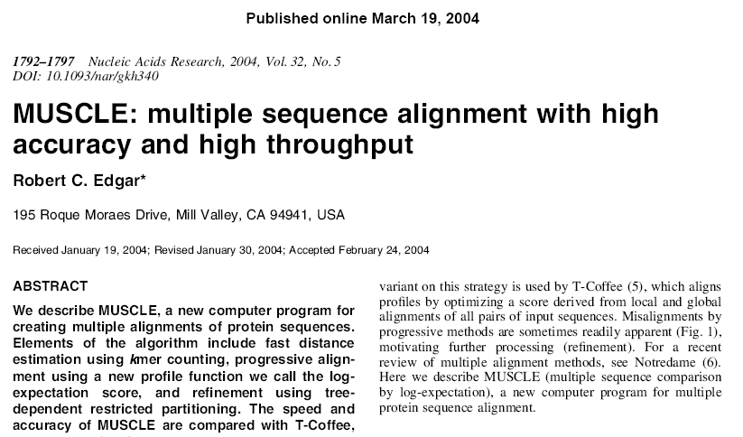
MUSCLE is a better aligner

Slide 23
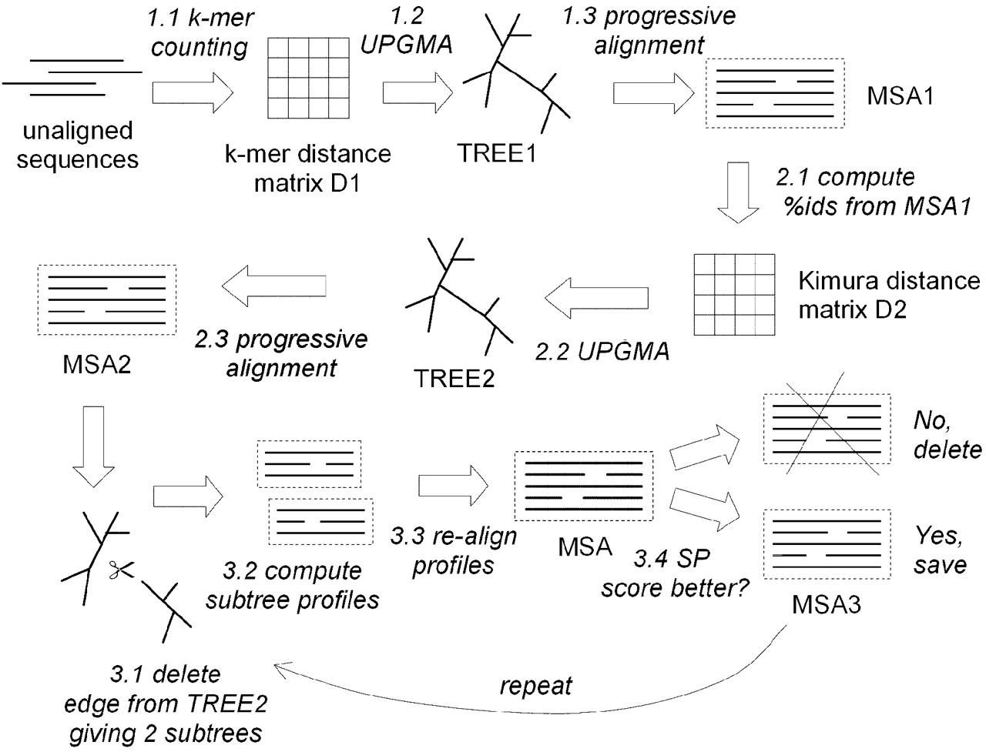
MUSCLE scheme

Slide 24
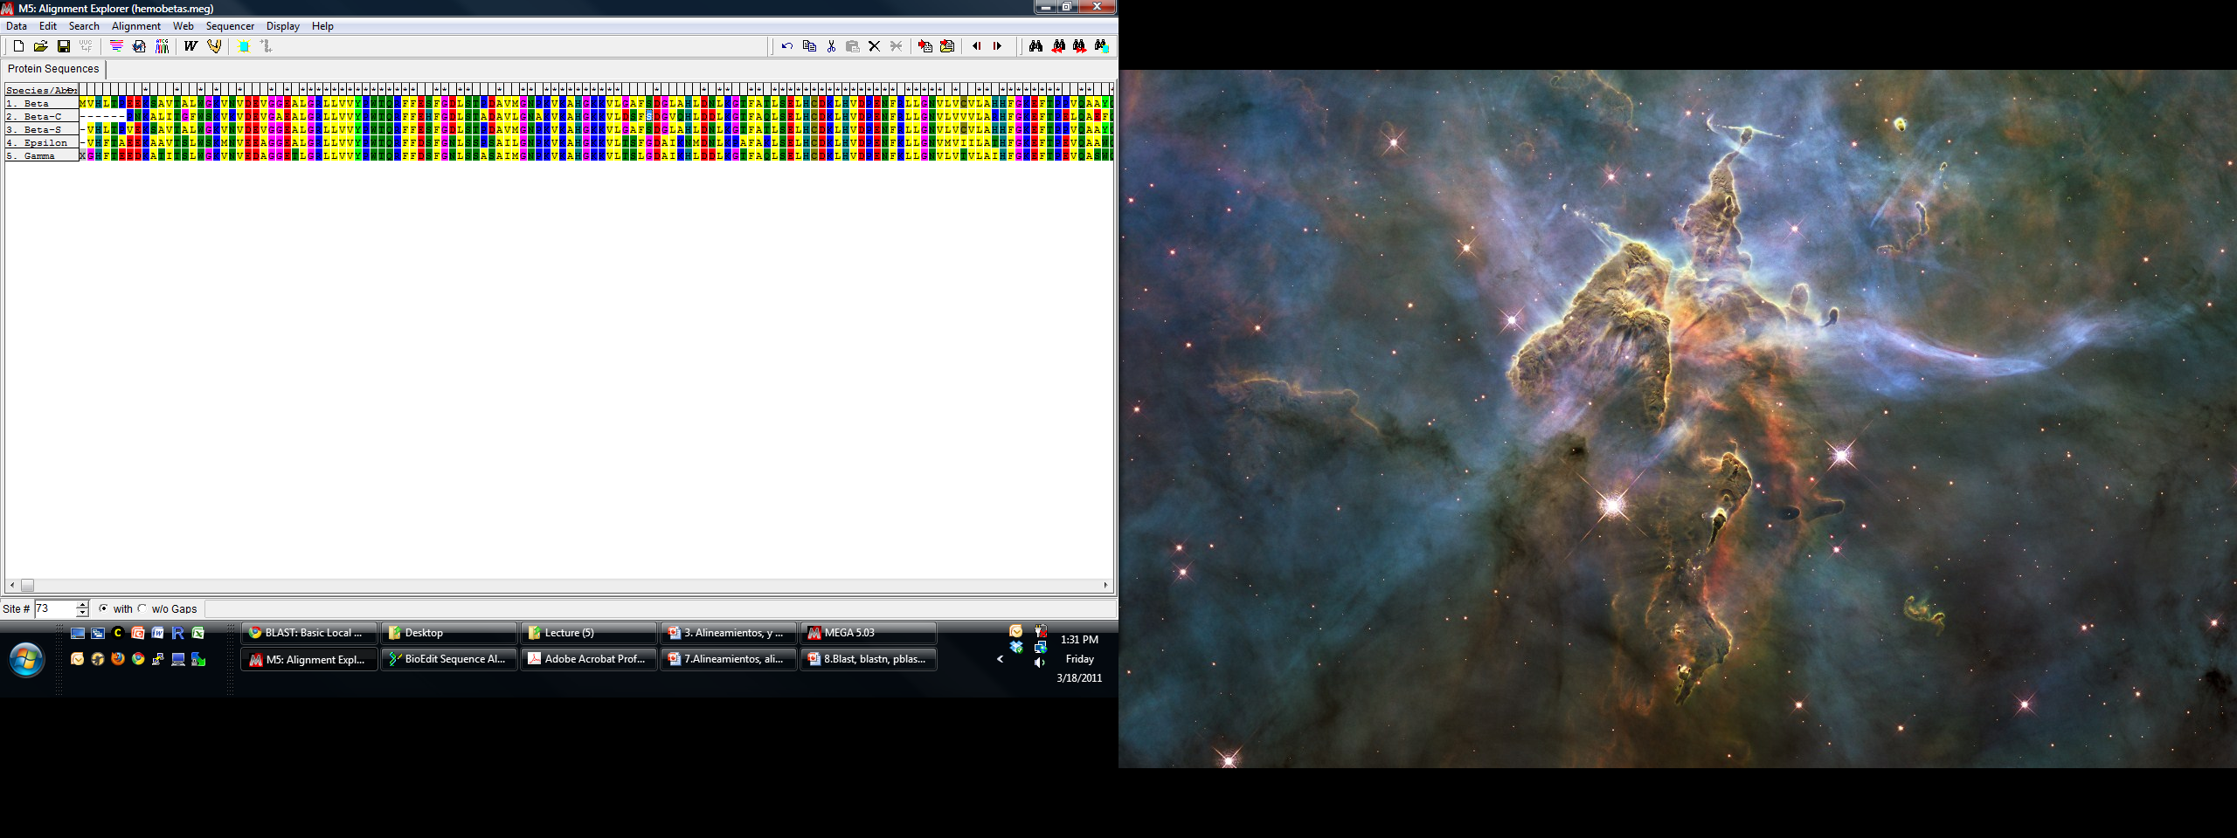
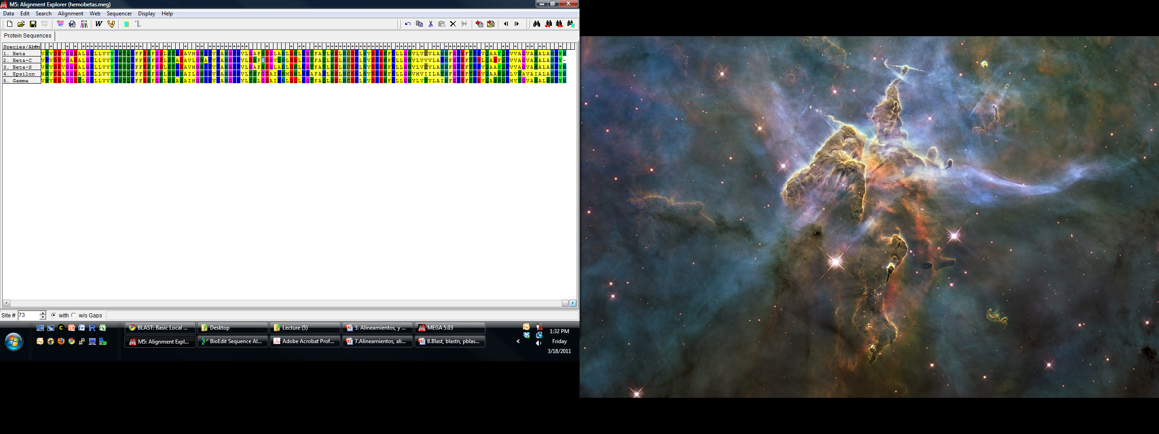
Human beta hemoglobin variants
99
Beta
Beta-S
Beta-C
Epsilon
97
Gamma
0.05

Slide 25
Summary alignment
Objective: Find similarity to infer function
Use set of rules to maximize similarity and alignment score
Selection of parameters is non-trivial
Can be global or local

Slide 26

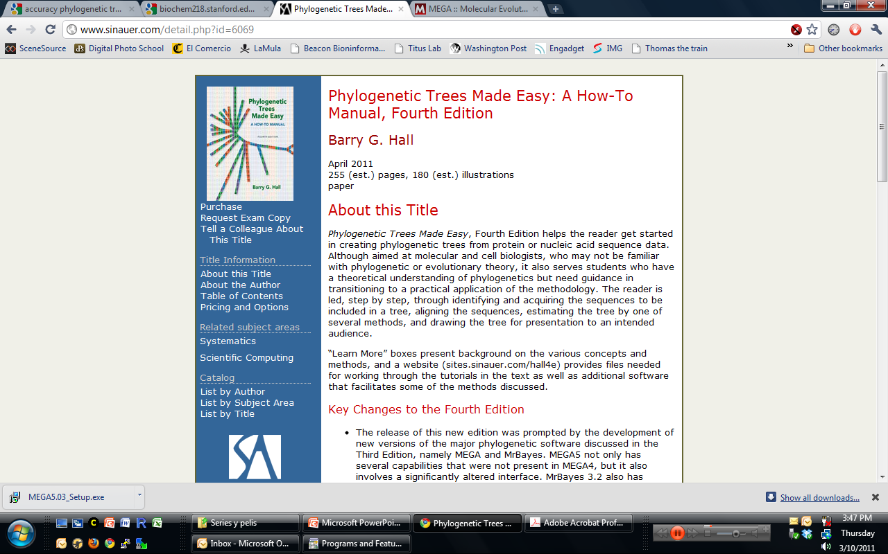
Phylogenetic analysis
Goals:
Reconstruct evolutionary relationships
Phylogenetic trees
Reconstruct ancestral sequences
Detect adaptive evolution

Slide 27
Algorithmic or distance-based
Tree searching or character-based
Makes pairwise comparisons and constructs tree from distance matrix
Fast and produces one tree
Neighbor joning, UPGMA
Constructs many trees and then picks best tree or set of trees
Uses data from all sequences for a given position
Slower and produces many trees
Maximum parsimony, Maximum Likehood, Bayesian
Determine substitution model
Tree
building
Tree
evaluation
Alignment

Slide 28
Evolutionary models
Estimates the branch length based on substitution probabilities
Most related sequences have positions that have mutated several times
Different codon positions have different mutation rates
Transversions are more frequent than transitions
At protein level changes can be to a similar amino acid
1.0
0.8
0.6
0.4
0.2
0
Observed p-distance
(francion of non- identical site)
0 0.5 1 1.5 2
Average number of mutations per site

Slide 29
How reliable is my tree
Bootstrap test
Samples with replacement alignment and constructs alternative trees with new alignment
23512
AGGAA
AGAAA
TGGAT
A
100
B
12345
AAGTG
AAGAA
ATGTG
42
D
100
C
Bootstrapped tree
12451
AATGA
AAAAA
ATTGA
A
100
B
D
100
C
Collapsed tree

Slide 30
Distance based trees
Start with alignment
Calculate distances
Correct distance
Substitution matrix
Jukes-Cantor
Kimura 2-parameter
Group sequences according to distance
UPGMA
Resuls in a single tree with constant rates of evolution at all branches
Shows group but not distances
Neighbor joining
Single tree with different rates

Slide 31
Neighbor joining
UPGMA

Slide 32
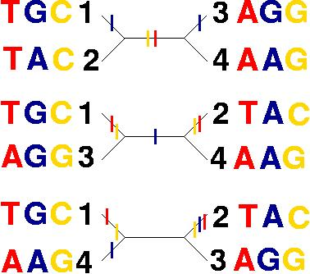
Maximum parsimony trees
Finds trees that can be created using the small number of steps
Can produce multiple equally good trees
1: T G C
2: T A C
3: A G G
4: A A G
From:
http://artedi.ebc.uu.se/course/BioInfo-10p-2001/Phylogeny/Exercises/mp.html

Slide 33
91
TI00034G02
91
TI00034G02
100
Geobacter humireducens AY187306
100
Geobacter humireducens AY187306
99
TI00033C06
99
TI00033C06
Trichlorobacter thiogenes (T) AF223382
Uncultured Geobacter sp. KB-1 1 AY780563
36
100
TI00045B10
100
TI00045B10
58
Uncultured Geobacter sp. KB-1 1 AY780563
20
Trichlorobacter thiogenes (T) AF223382
32
TI00033D05
Geobacter metallireducens GS-15 CP000148
100
Uncultured delta proteobacterium AKYG...
38
100
TI00033D05
Geobacter metallireducens GS-15 CP000148
Uncultured delta proteobacterium AKYG...
TI00034E04
50
TI00034E04
99
Geobacter argillaceus G12 DQ145534
99
Geobacter argillaceus G12 DQ145534
Pseudomonas stutzeri (T) U26262
Pseudomonas stutzeri (T) U26262
91
TI00034G02
91
TI00034G02
100
Geobacter humireducens AY187306
100
Geobacter humireducens AY187306
99
TI00033C06
99
TI00033C06
TI00045B10
Trichlorobacter thiogenes (T) AF223382
100
Trichlorobacter thiogenes (T) AF223382
100
TI00045B10
20
Uncultured Geobacter sp. KB-1 1 AY780563
58
Uncultured Geobacter sp. KB-1 1 AY780563
Geobacter metallireducens GS-15 CP000148
Geobacter metallireducens GS-15 CP000148
38
100
TI00033D05
38
100
TI00033D05
Uncultured delta proteobacterium AKYG...
Uncultured delta proteobacterium AKYG...
50
TI00034E04
50
TI00034E04
99
Geobacter argillaceus G12 DQ145534
99
Geobacter argillaceus G12 DQ145534
Pseudomonas stutzeri (T) U26262
Pseudomonas stutzeri (T) U26262

Slide 34
A consensus tree condenses branches not supported by a given consensus threshold
These are not bootstraps but consensus of the optimal trees

Slide 35
Maximum likehood
Looks for a tree that under some model of evolution maximizes the likehood of observing the data
Uses information for all sequences at each position in the alignment
Almost always recover one tree (more can be requested)
Likehood of resulting tree is known

Slide 36
Neighbor joining
Maximum likehood
LogL=-2259

Slide 37
Bayesian tree
Variation of ML trees
Produces multiples trees
Easy to interpret because frequency of a given clade is virtually same as probability of that clade
Process is iterative until tree cannot be improved to certain extent

Slide 38
What method is best?
Speed ¹
NJ>MP>ML>Bayesian
Accurracy ²
NJ<MP<ML<Bayesian
Ogden and Rosenberg 2006
Easy of Interpretation
One tree >multiple trees
 | NJ | MP | ML | B
Small Data | 1 s | 3 s | 6 s
Small data +boots | 9 s | 10 min | 1h 34 min | 29 min 40 s
Large Data | 1s | 22 s | 3 min 29s
Large data +boots | 86 s | 10 h 2 min | 58 h | 6h 33min
Small Data = 23 seqs, 453 sites,
Large data = 77 seqs, 1464 sites
1. From Hall 2008. Phylogenetic tree made easy. Third edition.
2. Ogden and Rosenberg 2006, Syst. Biol. 55:314-328

Slide 39
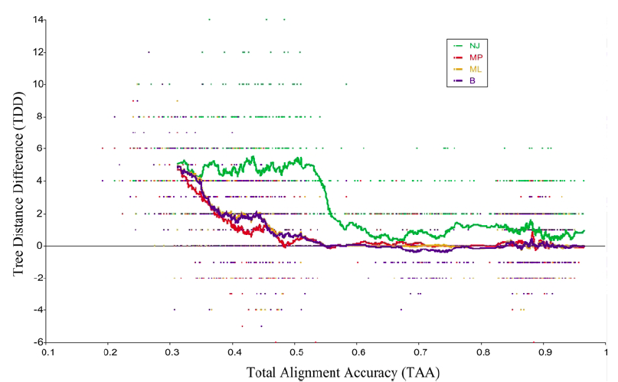
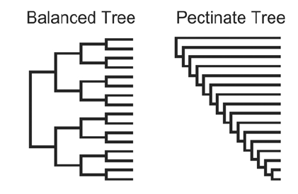
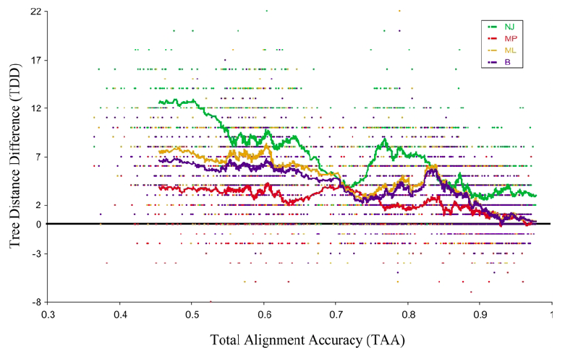
Accuracy depends on tree topology

Slide 40
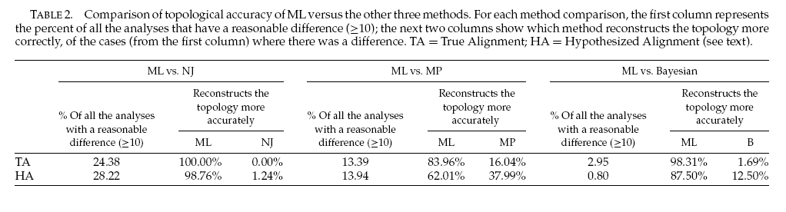
ML and heuristic trees are generally more accurate

Slide 41
Tips
Always include reference sequences
Help evaluate alignment
For 16S rRNA genes, adding a type strains links phylogeny with taxonomy
Outgroups help define direction of evolution
More than 50 sequences are hard to analyze , visualize, and interpret
If sequences are distant enough, all methods are accurate enough

Slide 42
What to do if my tree is not good enough
Fingerprinting
Multi Locus strain typing (MLST)
Strain level resolution
Pick 7-8 genes that are not laterally transferred
Whole gene tree
Average Nucleotide identity (ANI)
Requires complete genomes
Calculates identity among orthologous genes
At least 30% amino acid identity and at least 70% alignable region)

Slide 43
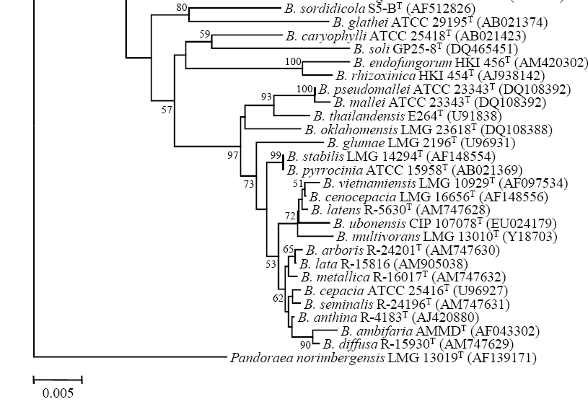
Burkholderia 16S rRNA tree
16S rRNA tree
Modified from Aizawas et al. 2010.Int J Syst Evol Microbiol. 60:2036-41.

Slide 44
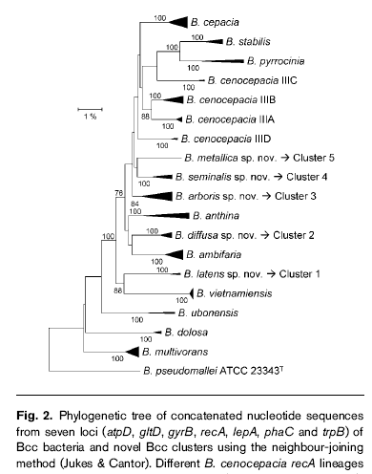
Burkholderia cenocepacia complex MLST
MLST of seven genes
From Vanlaere et al, 2008, Int.J. Syst.Evo. Microbio, 58:580–1590

Slide 45
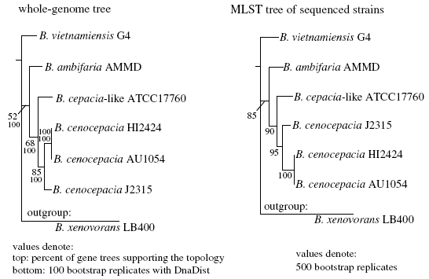
Whole genome phylogeny
Konstantinidis and Tiedje 2004. Phil. Trans. R. Soc. B (2006) 361, 1929–1940

